Slide 1
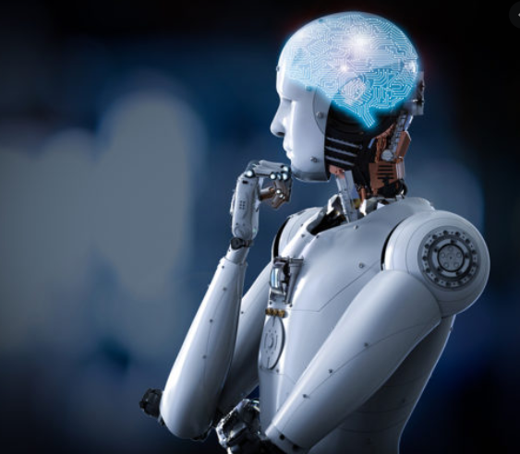

Generative Adversarial Network
دانشگاه صنعتی امیرکبیر
تیم ما :
امیرمحمد نائینی9623109
درسا نظری 9623113
زیر نظر استاد سرکار خانم دکتر مزلقانی

Slide 2


List of content
Introduction of GANs
CNN
DCGAN
Implementation

Slide 3
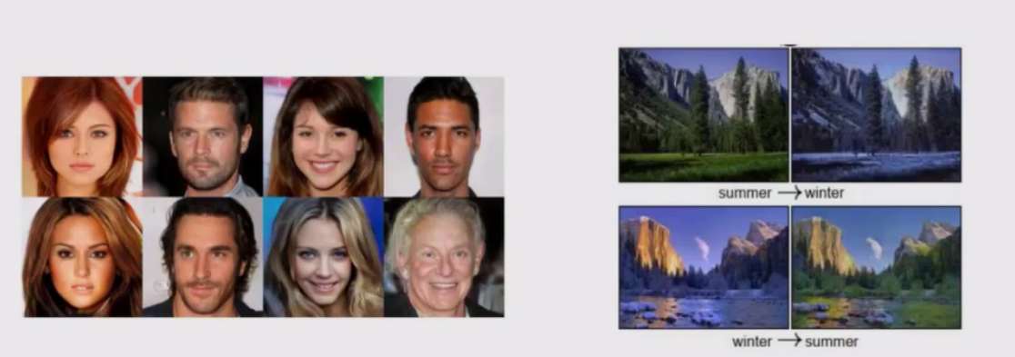
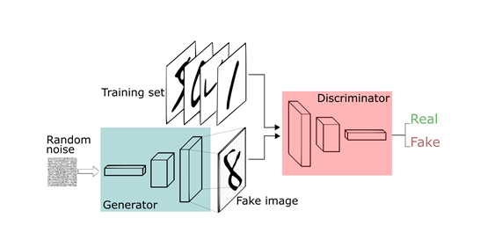
What is GAN ?
Main Idea
Applications
Music Generation
Deep Fake
Generating fake Faces
Future of this idea

Slide 4

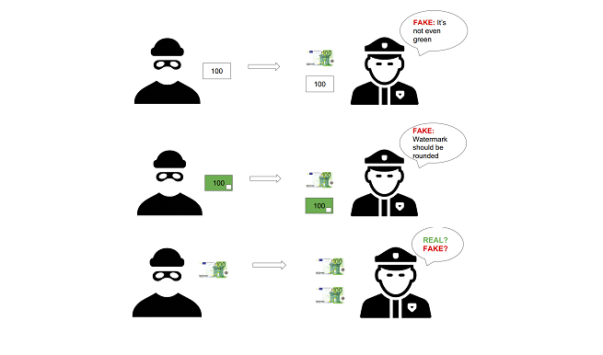
GoodFellow’s Article
Thief as Generator
Police as Discriminator
Competition between two teams
Weaker one is fooled by the other one

Slide 5
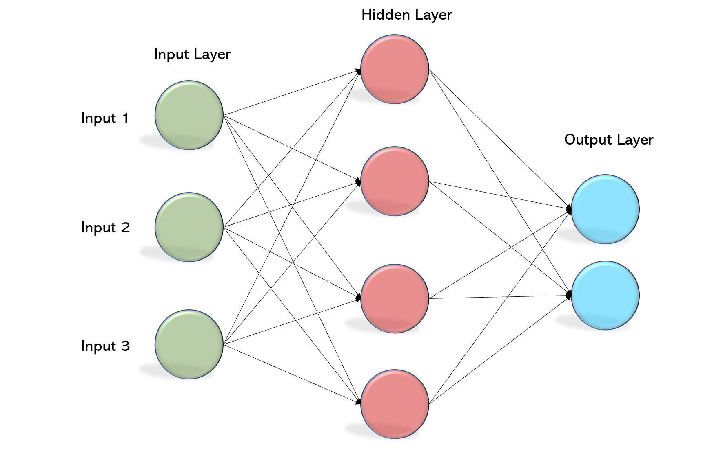
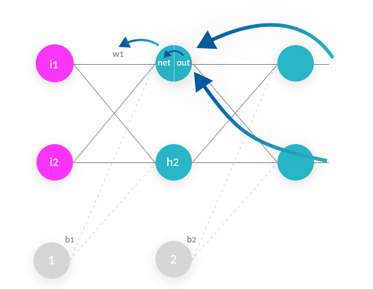
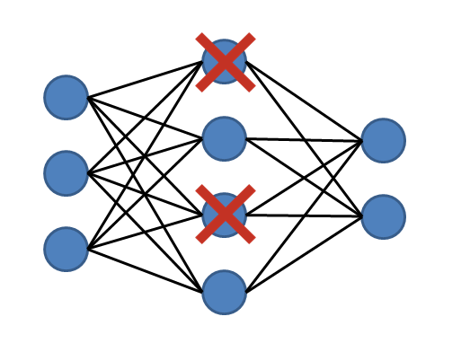
GoodFellow’s Article
Drop out and Back Propagation
Noise As Input
MLP for Gen and Disc
Using BP and Dropout for Train

Slide 6
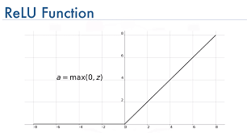

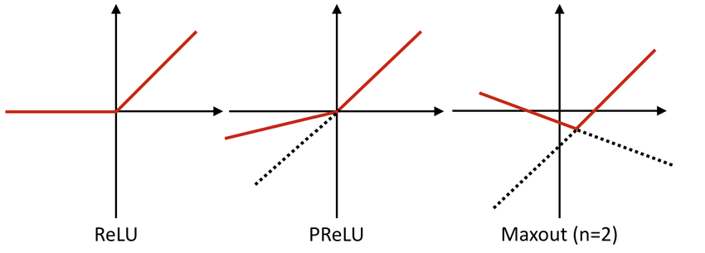
MLPs in Goodfellows Gan
Relu and Sigmoid as activation function
In Generation Part
MaxOut as activation Function
In Discrimination Part

Slide 7
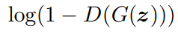
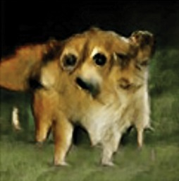
Equation 1
Hard to Train
Objective :
Maximizing the Equation 1
D and G play two-player minimax game with value function V (G, D)
Second Term Saturates at first
Equation 2

Slide 8
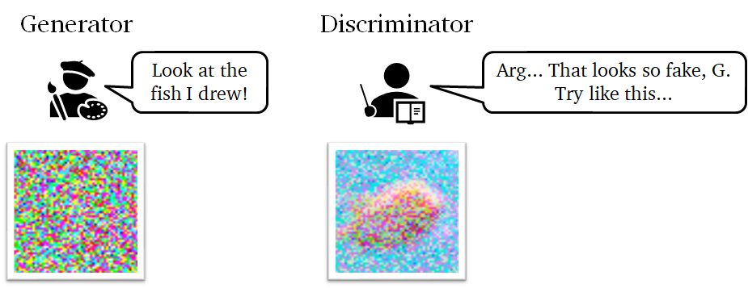
Training Tips
Training D independently
Overfit on finite data sets
Nash Equilibria
(D = 0.5)
Statisical Advantage
Disc helps Gen

Slide 9


Convolutional Neural Network
CNN
Convolution Layer
Stride and Padding
Flatten layer

Slide 10
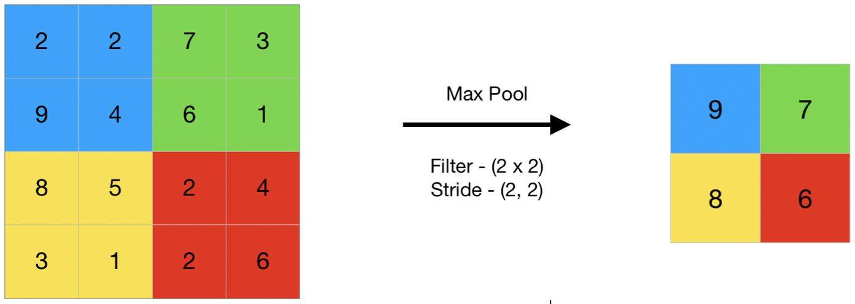
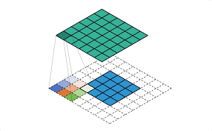
Convolutional Neural Network
CNN
Pooling Layer
Downsampling
Conv Transpose
Upsampling

Slide 11
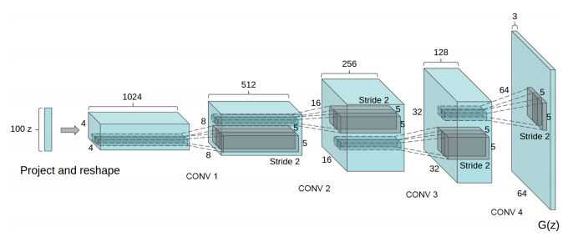
DCGAN
Advantages:
• Helps the stability of training GANs
• Allows deeper generators
• Higher resolution result

Slide 12
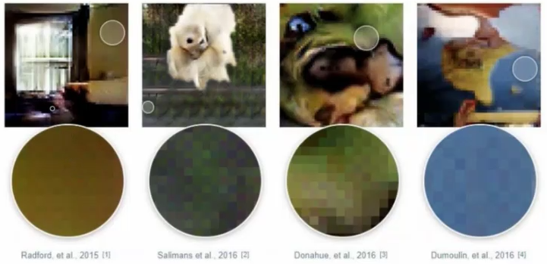
Problem : chekerboard artifact

Slide 13
Practical Techniques:
• Replace any pooling layers with strided convolutions (discriminator) and fractional-strided convolutions (generator).
• Use batchnorm in both the generator and the discriminator.
• Remove fully connected hidden layers for deeper architectures.
• Use ReLU activation in generator for all layers except for the output, which uses Tanh.
• Use LeakyReLU activation in the discriminator for all layers.

Slide 14
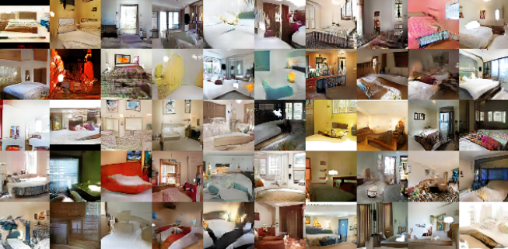
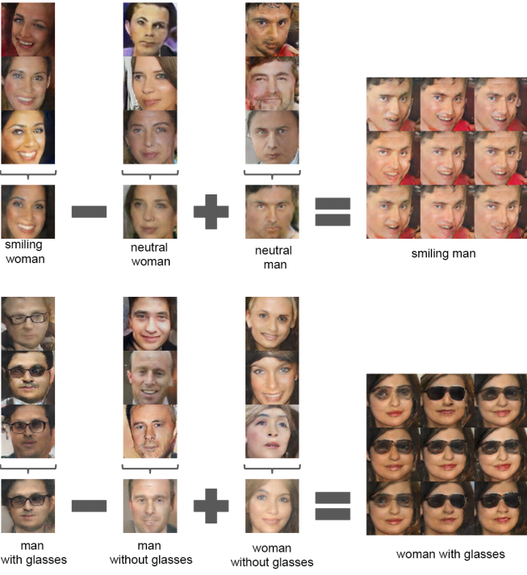
Results

Slide 15
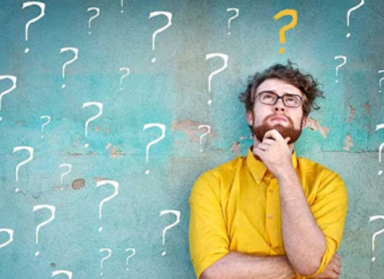
Is it new?

Slide 16
Referenses
Generative Adversarial Nets Ian J. Goodfellow
Dumoulin,Visin.A guide to convolution arithmetic for deep learning
Unsupervised Representation Learning with Deep Convolutional Generative Adversarial Networks : Alec Radford & Luke Metz

Slide 17

تشکر از حسن نظر شما
پایان ارائه

